Slide 1

API DAY | Feb. 16. 2023
NILS HARTMANN
https://nilshartmann.net
GraphQL
what is it all about?
Slides (PDF): https://graphql.schule/api-day2023

Slide 2


https://nilshartmann.net
NILS HARTMANN
nils@nilshartmann.net
Software Developer, Architect and Coach from Hamburg
Java, Spring, GraphQL, TypeScript, React
https://graphql.schule/video-kurs
https://reactbuch.de

Slide 3
"GraphQL is a query language for APIs and a runtime for fulfilling those queries with your existing data"
- https://graphql.org
GraphQL

Slide 4
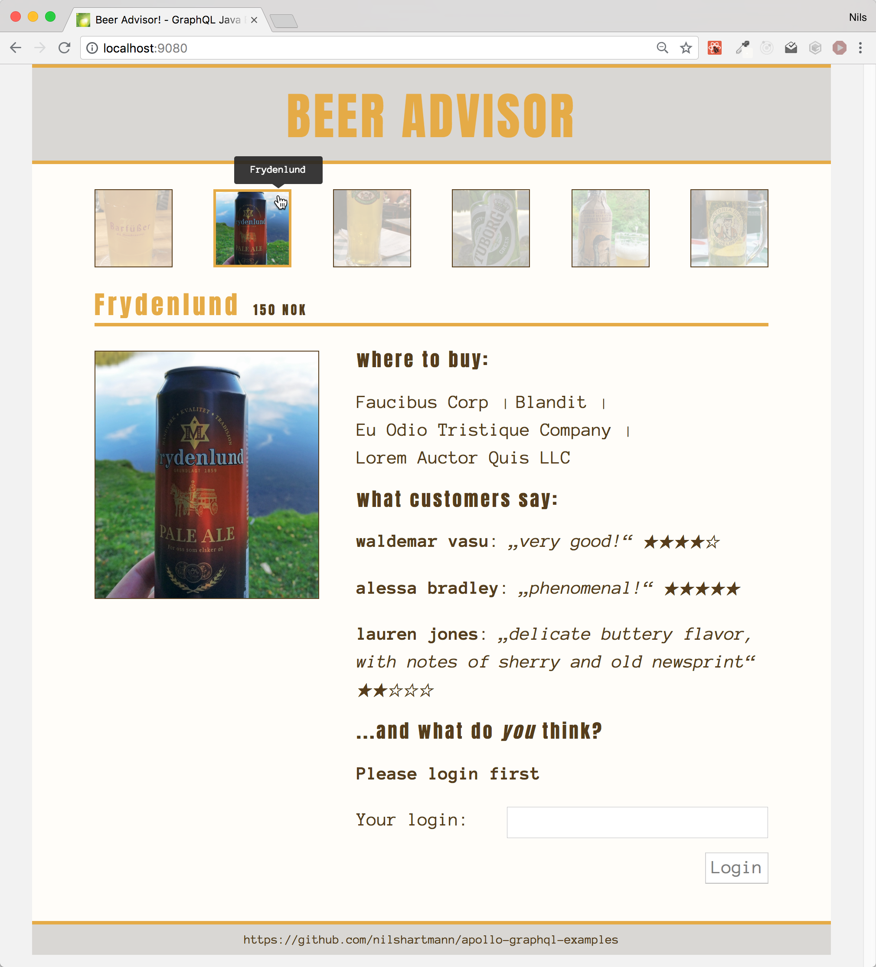
Source: https://github.com/nilshartmann/spring-graphql-talk
Example application

Slide 5
An API for the Beer Advisor

Slide 6
An Api for the BeerAdvisor
Approach 1: Backend defines the API / data
/api/beer
/api/shop
/api/rating

Slide 7
An Api for the BeerAdvisor
Approach 2: Client defines the API based on its requirements, views, use-cases, ...
/api/home
/api/beer-view
/api/shopdetails

Slide 8
An Api for the BeerAdvisor
Approach 3: GraphQL...

Slide 9
An Api for the BeerAdvisor
Approach 3: GraphQL...
As approach 1: Server defines the data model

Slide 10
An Api for the BeerAdvisor
Approach 3: GraphQL...
As approach 1: Server defines the data model
...but the client can choose itself in every request the data it wants to read
{ beer { id price { shops { name } }

Slide 11
GraphQL
Specifikation: https://spec.graphql.org/
Developed by the GraphQL Foundation
Spec includes:
Language
Type System
General execution behaviour

Slide 12
GraphQL
Specifikation: https://spec.graphql.org/
Developed by the GraphQL Foundation
Spec includes:
Language
Type System
General execution behaviour
No implementation!
Server reference implementation: graphql-js

Slide 13
GraphQL APIs
With GraphQL we publish an api based on our domain model
What data we expose is up to us
We define the structure of the data we want to expose
👉 We explicitly define, how our API looks and behaves

Slide 14
GraphQL APIs
With GraphQL we publish an api based on our domain model
What data we expose is up to us
We define the structure of the data we want to expose
👉 We explicitly define, how our API looks and behaves
👉 GraphQL does not create an API "magically" for us

Slide 15
"GraphQL is a query language for APIs and a runtime for fulfilling those queries with your existing data"
- https://graphql.org
GraphQL

Slide 16
Query Language
With the query language, you select fields from objects
Objects
Fields

Slide 17
Query Language
With the query language, you select fields from objects
All queries start on a special root object
Objects
Root-Object
Fields

Slide 18
Query Language
With the query language, you select fields from objects
All queries start on a special root object
You can only follow paths defined in the schema
Objects
Root-Object
Fields
query { beers { ratings { comment } } }

Slide 19
Query Language
With the query language, you select fields from objects
All queries start on a special root object
You can only follow paths defined in the schema
No other "joins" possible
Objects
Root-Object
Fields
⚡️
query { shops { id } }

Slide 20
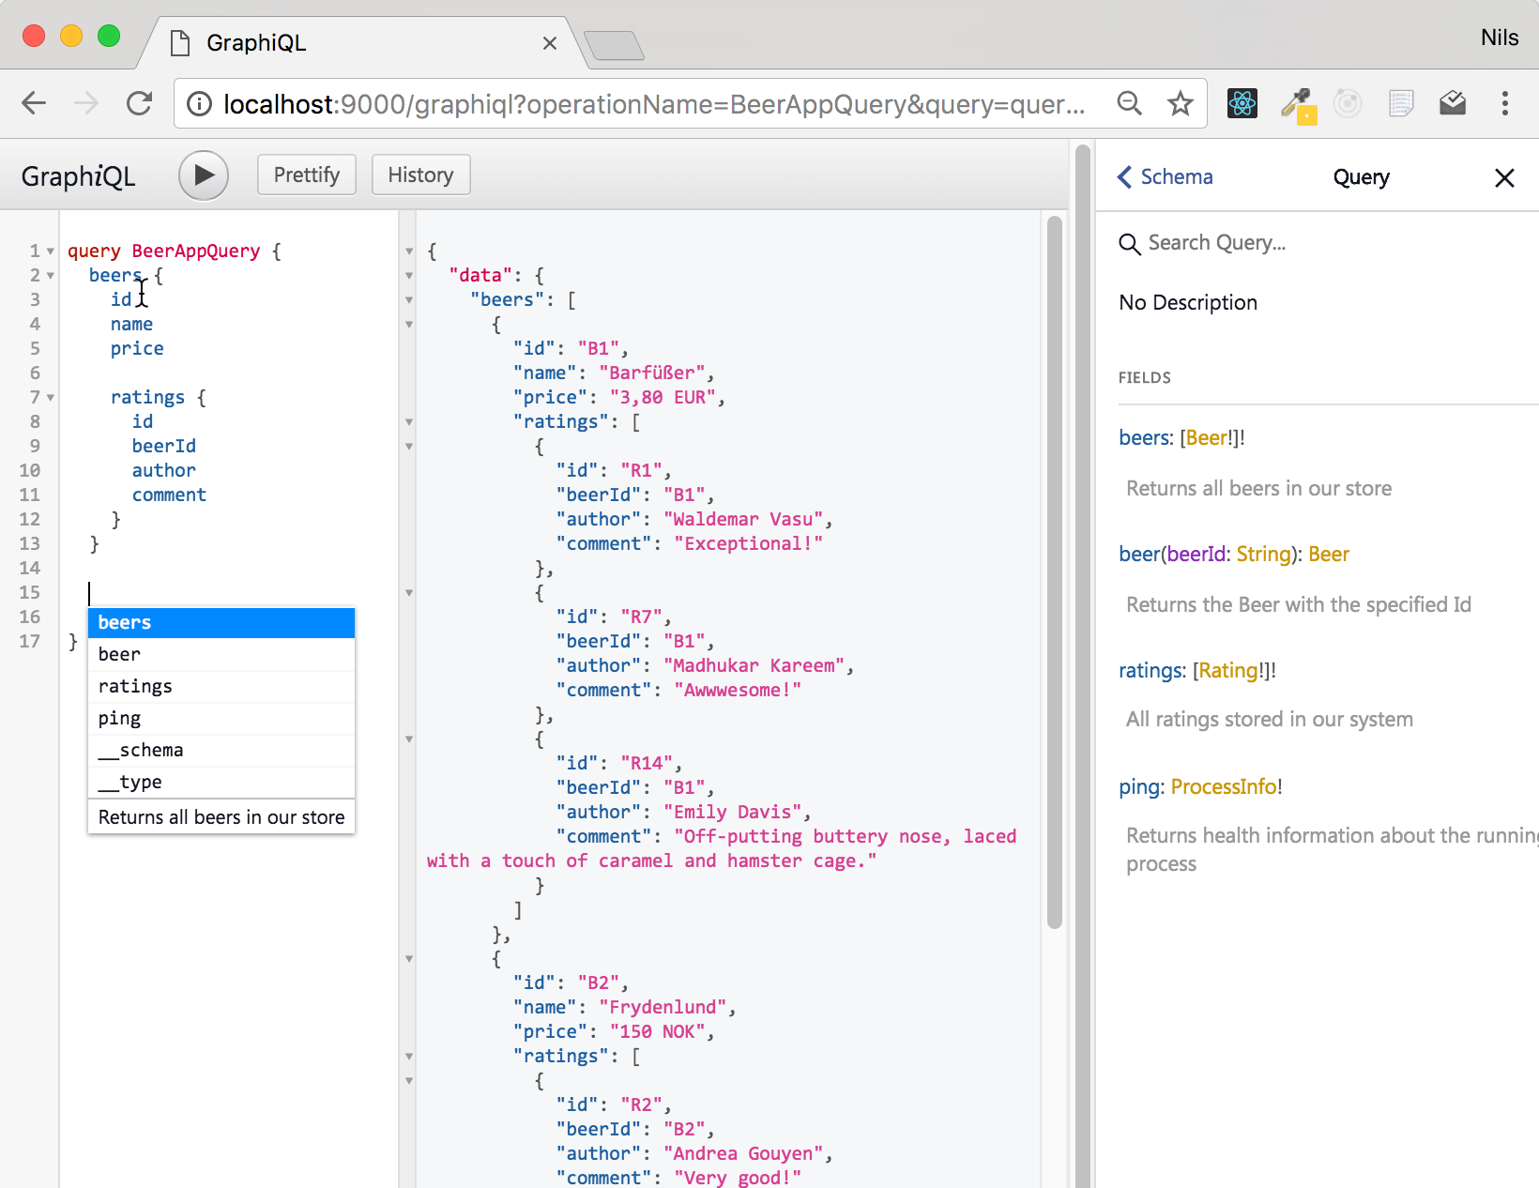
Demo Query Language
https://github.com/graphql/graphiql

Slide 21
query Language
Structured Language to query/request data from your API
With the language, you select fields from object graphs

Slide 22
query Language
Structured Language to query/request data from your API
With the language, you select fields from object graphs
Fields can have arguments

Slide 23
query Language
Query Result
Identical structure as your query

Slide 24
query Language: Operations
Operation: describe, what the query should do
query, mutation, subscription

Slide 25
query Language: Mutations
Mutations
Mutations can be used to modifiy data
(would be POST, PUT, PATCH, DELETE in REST)

Slide 26
query Language: Mutations
Subscription
Client of your API can subscribe to Server Events, published by the API

Slide 27
executing queries
Queries usually are executed via HTTP
One single HTTP endpoint /graphql
queries are sent using POST (or sometimes GET)
Other HTTP verbs do not matter
Implementation depends on your serverside framework
There is a specification being developed standardizing the server protocol

Slide 28
Part II
GraphQL
Server

Slide 29
Runtime (AKA: Your application)
"GraphQL is a query language for APIs and a runtime for fulfilling those queries with your existing data"
- https://graphql.org
GraphQL
Server

Slide 30
GraphQL backends
Implementing a GraphQL backend
Specification does not a force a specific implementation
There are frameworks for a lot of programming languages
Almost all of them are following the same principles

Slide 31
GraphQL backends
Processing a GraphQL request
GraphQL request ("document") is received by your backend

Slide 32
GraphQL backends
Processing a GraphQL request
GraphQL request ("document") is received by your backend
GraphQL framework parses and validates the operations
Syntax valid? Valid according to schema?
If invalid, error is sent to the client

Slide 33
GraphQL backends
Processing a GraphQL request
GraphQL request ("document") is received by your backend
GraphQL framework parses and validates the operations
Syntax valid? Valid according to schema?
If invalid, error is sent to the client
Otherwise the request will be processed...

Slide 34
GraphQL backends
Processing a GraphQL request
For each field, a resolver function is invoked by the framework
A resolver function determines the value for a field

Slide 35
GraphQL backends
Processing a GraphQL request
For each field, a resolver function is invoked by the framework
A resolver function determines the value for a field
It's our task to implement the resolver functions
("Implement a GraphQL API" == "Implement resolver functions")

Slide 36
GraphQL backends
Processing a GraphQL request
For each field, a resolver function is invoked by the framework
A resolver function determines the value for a field
It's our task to implement the resolver functions
("Implement a GraphQL API" == "Implement resolver functions")
Result from resolver functions is validated by the GraphQL framework

Slide 37
GraphQL backends
Processing a GraphQL request
For each field, a resolver function is invoked by the framework
A resolver function determines the value for a field
It's our task to implement the resolver functions
("Implement a GraphQL API" == "Implement resolver functions")
Result from resolver functions is validated by the GraphQL framework
Result is sent back to client

Slide 38
Implementing a GraphQL API
Implementing a GraphQL API
Step one: defining a schema that expresses your API
Step two: implement the logic for determining the data

Slide 39
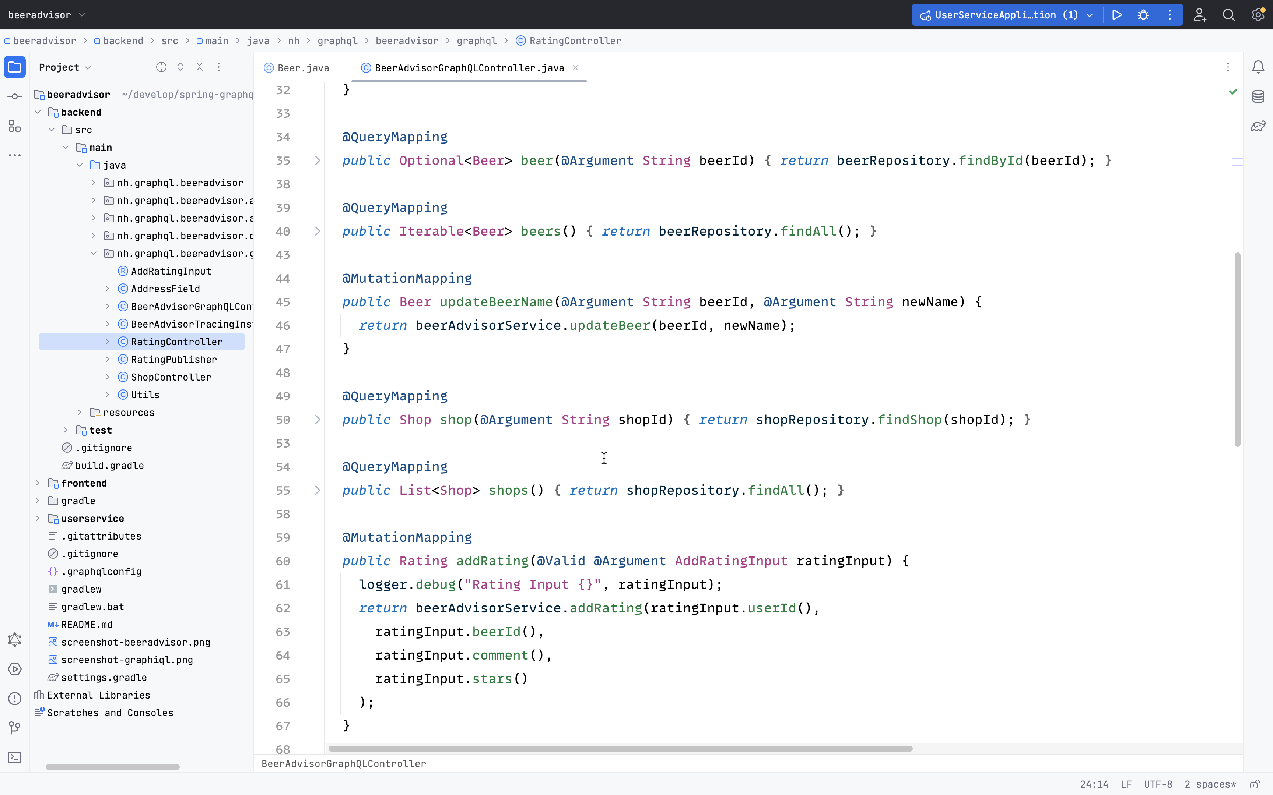
Demo GraphQL with Java
https://spring.io/projects/spring-graphql

Slide 40
GraphQL Schema
Step 1: GraphQL schema
Every GraphQL API must be defined in a Schema
The schema defines Types and Fields
Only requests and responses that match the schema are processed and returned to the client
Schema Definition Language (SDL)

Slide 41
GraphQL Schema
Schema Definition with SDL
Object Type
type Rating { id: ID!
comment: String! stars: Int
}
Fields

Slide 42
GraphQL Schema
Schema Definition with SDL
type Rating { id: ID!
comment: String! stars: Int
}
Return Type (non-nullable)
Return Type (nullable)

Slide 43
GraphQL Schema
Schema Definition with SDL
type Rating { id: ID!
comment: String! stars: Int
author: User! }
type User {
id: ID!
name: String!
}
Referenz auf anderen Typ

Slide 44
GraphQL Schema
Schema Definition with SDL
type Rating { id: ID!
comment: String! stars: Int
author: User! }
type User {
id: ID!
name: String!
}
type Beer {
name: String!
ratings: [Rating!]!
}
Liste / Array

Slide 45
GraphQL Schema
Schema Definition with SDL
type Rating { id: ID!
comment: String! stars: Int
author: User! }
type User {
id: ID!
name: String!
}
type Beer {
name: String!
ratings: [Rating!]!
ratingsWithStars(stars: Int!): [Rating!]!
}
Arguments

Slide 46
GraphQL Schema
Root-Types: Entry-Points into the API (Query, Mutation, Subscription)
Root-Type
("Query)
type Query { beers: [Beer!]!
beer(beerId: ID!): Beer }
type Mutation { addRating(newRating: NewRating): Rating! }
type Subscription {
onNewRating: Rating!
}
Root-Fields
Root-Type
("Mutation")
Root-Type
("Subscription")

Slide 47
GraphQL backends
Example: graphql-java
Note that there are other (high level) frameworks for Java (Spring for GraphQL, MicroProfile GraphQL) that you should consider, but all of these are backed by graphql-java

Slide 48
Data Fetchers
DataFetcher
A DataFetcher determines and returns the value for a Field
Required for all fields of your Root-Types (Query, Mutation)
For all other fields, Reflection is used (getter/setter, Maps, ...) by default
A DataFetcher is a functional Java interface

Slide 49
Data Fetchers
DataFetcher
In graphql-java resolver functions are called DataFetcher

Slide 50
Data Fetchers
DataFetcher
In graphql-java resolver functions are called DataFetcher
A DataFetcher determines and returns the value for a Field
Required for all fields of your Root-Types (Query, Mutation)
For all other fields, Reflection is used (getter/setter, Maps, ...) by default

Slide 51
Data Fetchers
DataFetcher
In graphql-java resolver functions are called DataFetcher
A DataFetcher determines and returns the value for a Field
Required for all fields of your Root-Types (Query, Mutation)
For all other fields, Reflection is used (getter/setter, Maps, ...) by default
A DataFetcher is a functional Java interface
interface DataFetcher<T> { T get(DataFetchingEnvironment environment); }

Slide 52
DataFetcher
Implementing DataFetchers
Example: A simple field
Schema Definition
type Query { beer(id: ID!): Beer
}

Slide 53
DataFetcher
Implementing DataFetchers
Example: A simple field
Schema Definition
type Query { beer(id: ID!): Beer
}
"data": {
"beer":
{ "name": "...", "price": 5.3 }
}
Query
query { beer(id: "B1")
{ name price }
}

Slide 54
DataFetcher
Implementing DataFetchers
Example: A simple field
Schema Definition
type Query { beer(id: ID!): Beer
}
"data": {
"beer":
{ "name": "...", "price": 5.3 }
}
Query
query { beer(id: "B1")
{ name price }
}
Data Fetcher
public class QueryDataFetchers {
DataFetcher<Beer> beer = new DataFetcher<>() {
public Beer get(DataFetchingEnvironment env) {
String id = env.getArgument("id");
return beerRepository.getBeerById(id);
}
};
}

Slide 55
DataFetcher
Implementing DataFetchers
Example: A simple field
Schema Definition
type Query { beer(id: ID!): Beer
}
"data": {
"beer":
{ "name": "...", "price": 5.3 }
}
Query
query { beer(id: "B1")
{ name price }
}
Data Fetcher
public class QueryDataFetchers {
DataFetcher<Beer> beer = new DataFetcher<>() {
public Beer get(DataFetchingEnvironment env) {
String id = env.getArgument("id");
return beerRepository.getBeerById(id);
}
};
}
Assume Beer Pojo
contains "name" and "price" property

Slide 56
DataFetcher
DataFetcher: Mutations
technically the same as queries, but you're allowed to modify data here
Schema Definition
input AddRatingInput { beerId: ID!
stars: Int!
}
type Mutation { addRating(input: AddRatingInput!): Rating!
}
Data Fetcher
public class MutationDataFetchers {
DataFetcher<Rating> addRating = new DataFetcher<>() {
public Rating get(DataFetchingEnvironment env) {
Map input = env.getArgument("input");
String beerId = input.get("beerId");
Integer starts = input.get("stars");
return ratingService.newRating(beerId, stars);
}
};
}

Slide 57
DataFetcher
DataFetcher: Subscriptions
Same as DataFetchers for Query, but must return Reactive Streams Publisher
Typically used in Web-Clients with WebSockets
import org.reactivestreams.Publisher;
public class SubscriptionDataFetchers {
DataFetcher<Publisher<Rating>> onNewRating = new DataFetcher<>() {
public Publisher<Rating> get(DataFetchingEnvironment env) {
Publisher<Rating> publisher = getRatingPublisher();
return publisher;
}
};
}
type Subscription {
onNewRating: Rating!
}

Slide 58
Object GraphS
DataFetcher for own Types (not Root Types)
By default graphql-java uses a "PropertyDataFetcher" for all fields that are not on Root Types
PropertyDataFetcher uses Reflection to return the requested data from your Pojo
(Fields not defined in your schema, but part of your Pojo are never returned to the client!)
Your returned Pojo and GraphQL schema might not match
Different/missing fields

Slide 59
Object GraphS
DataFetcher for own Types (not Root Types)
Example: There is no field "shops" on our Beer class
public class Beer {
String id;
String name;
...
}
query {
beer(id: 1) {
name
shops {
name
}
}
}
no 'shops' here 🤔

Slide 60
Object GraphS
DataFetcher for own Types (not Root Types)
You can write DataFetcher for all fields in your GraphQL API
Non-Root Fetcher works the same, as DataFetchers for Root-Fields
They receive their parent object as "Source"-Property from the DataFetchingEnvironment
query {
beer(id: 1) {
name
shops {
name
}
}
}
public class BeerDataFetchers {
DataFetcher<List<Shop>> shops = new DataFetcher<>() {
public String get(DataFetchingEnvironment env) {
Beer parent = env.getSource();
String beerId = parent.getId();
return shopRepository.findShopsSellingBeer(beerId);
}
};
}

Slide 61

HTTPS://NILSHARTMANN.NET | @nilshartmann
🌻
Thank you!
Slides: https://graphql.schule/api-day2023 (PDF)
Source code: https://github.com/nilshartmann/spring-graphql-talk
Contakt: nils@nilshartmann.net

